Slide 1
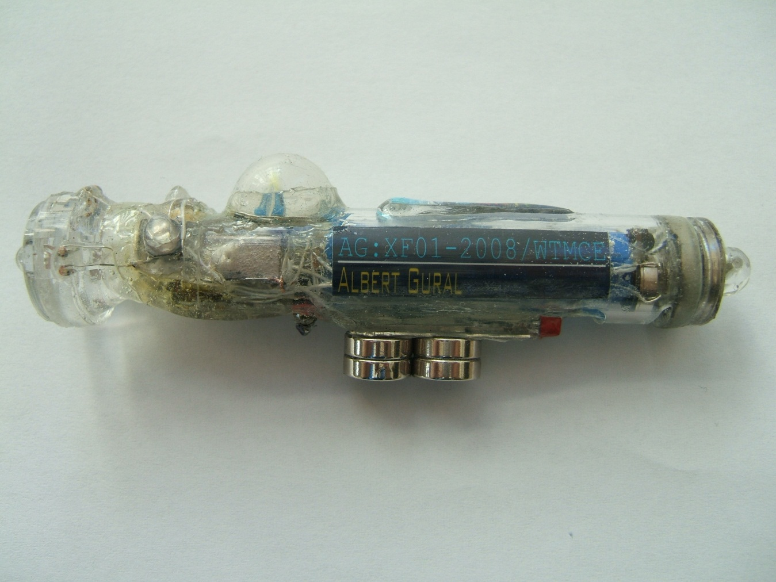
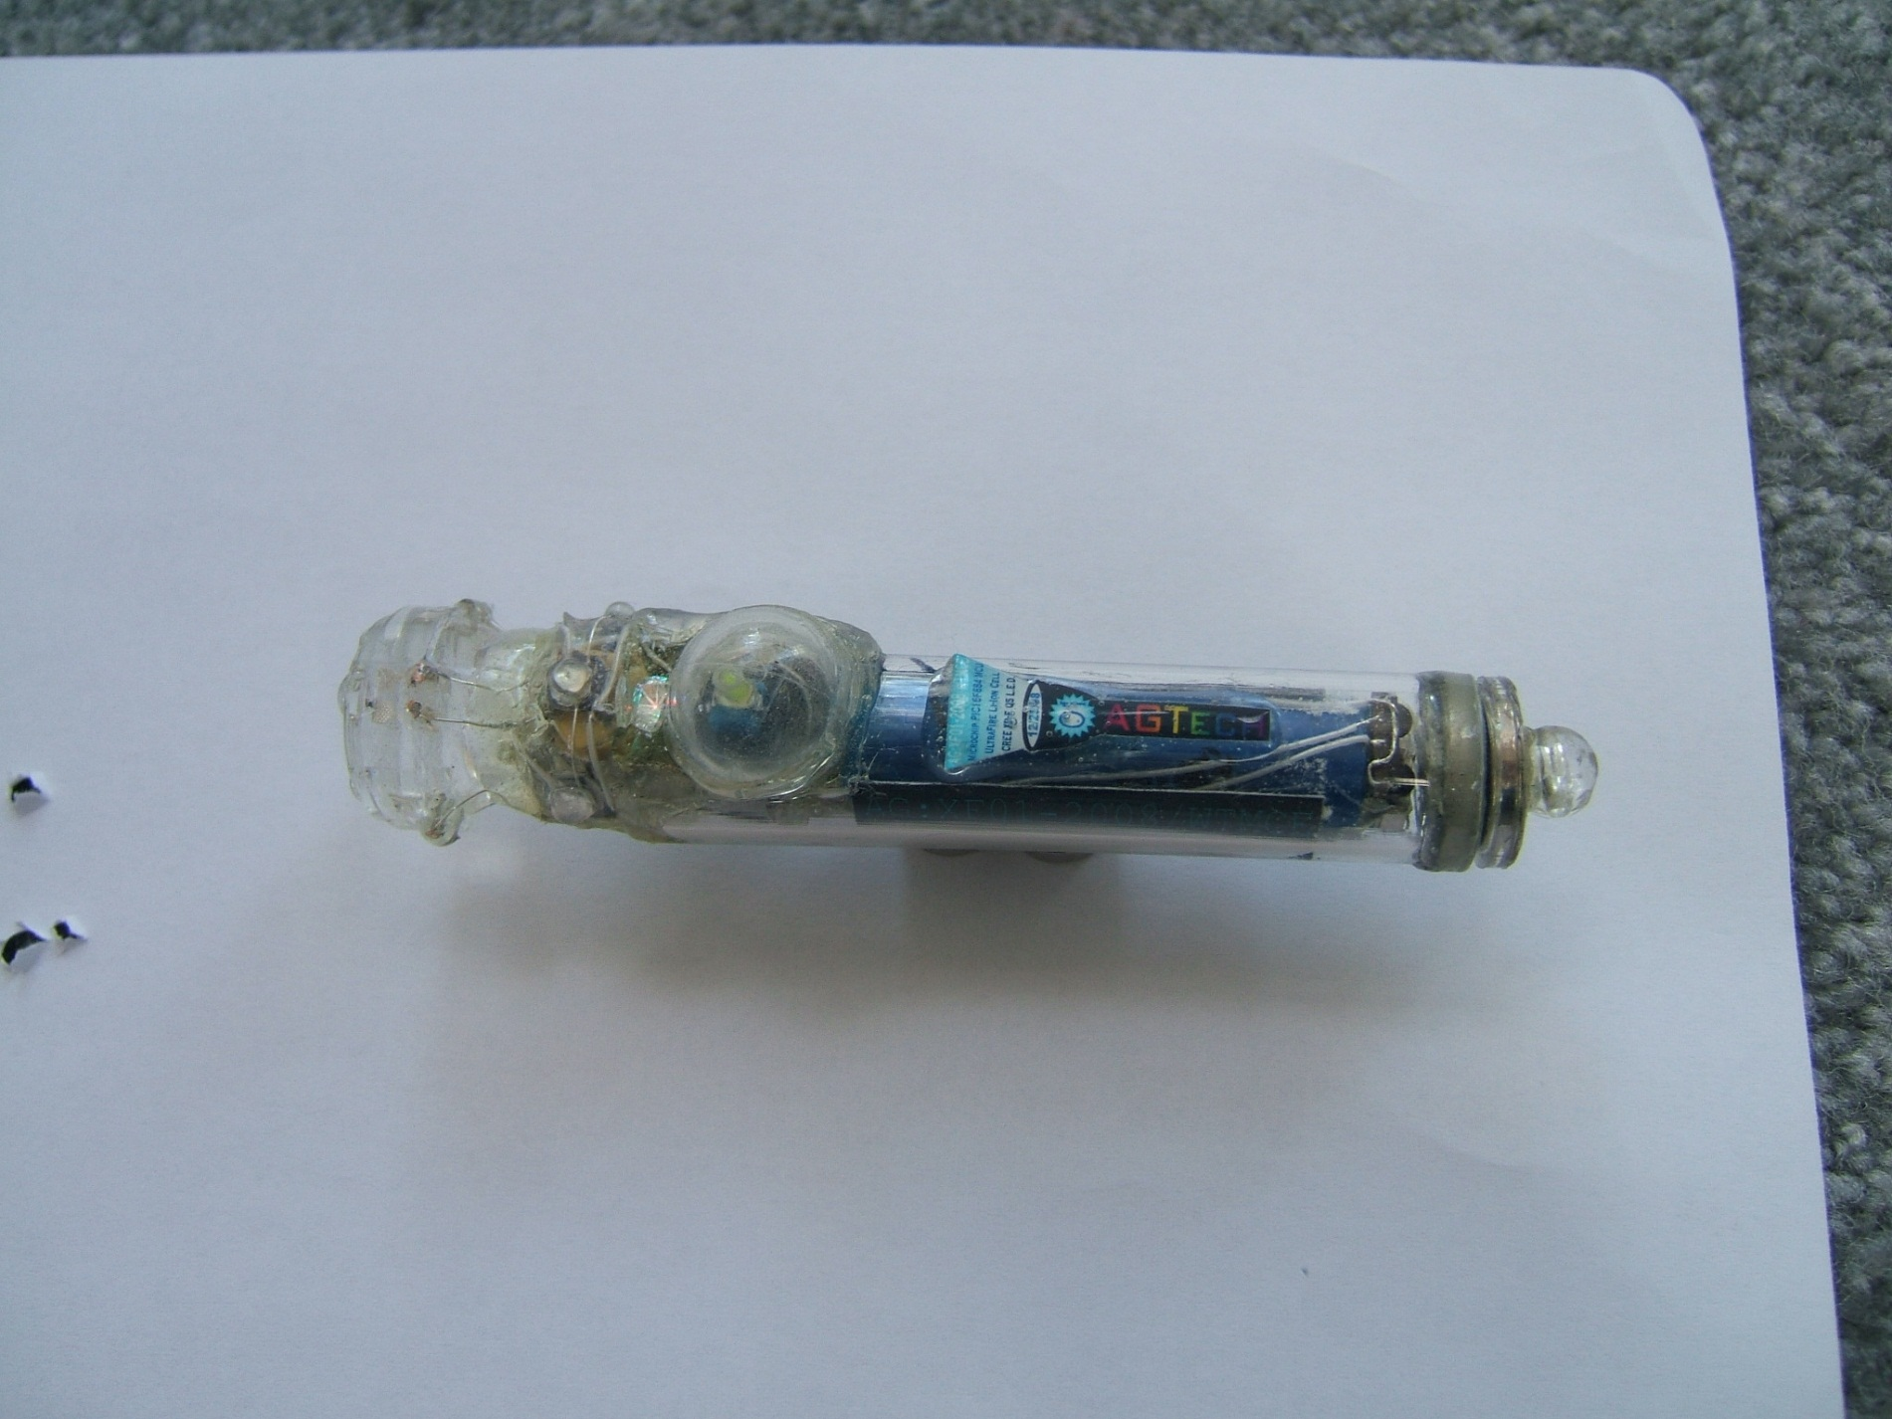
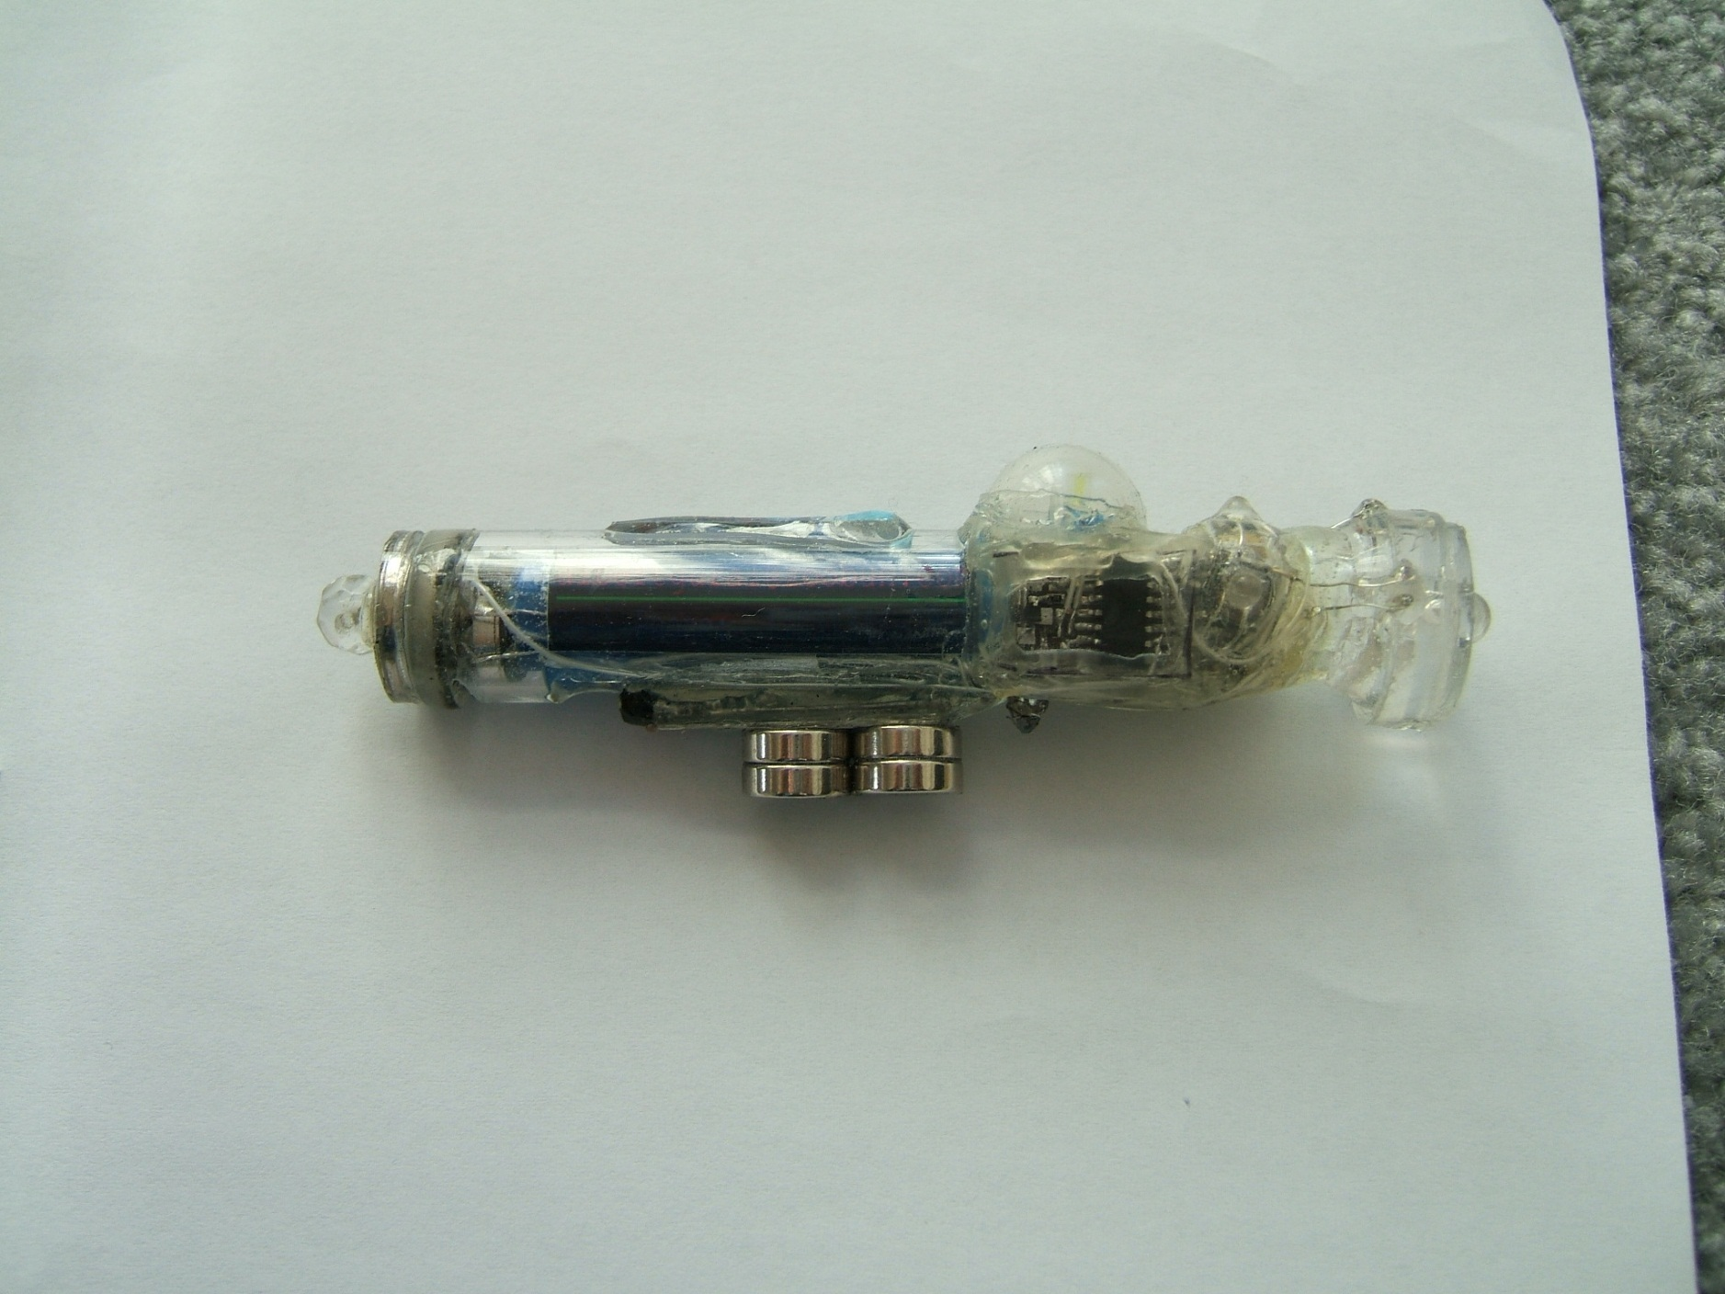
AG:XF01-2008/WTMCE
The Small, Ultra-bright, MCU Controlled, Extra Feature Flashlight!
Albert Gural
© 2009 AGTech, property of Albert Gural
This document may not be copied or distributed without consent of the owner.

Slide 2
Table of Contents
Overview of the flashlight/ history
Flashlight parts
Flashlight hardware cross section w/ descriptions
Circuit schematic diagram
Flashlight software flowchart
ASM. Code (AGXF01 OS v1.00)
Specifications about device and IR communication
Suggested IR transmitter hardware, schematic, and asm. code
Specification about charging (and reprogramming) through ports
Data tables/ charts
Operating the flashlight (detailed guide for users)
Pricing/ Package/ Summary

Slide 3
1.1 Flashlight/ History
Chapter 1 deals with the history and different flashlight series of the AG flashlights
Section 1.2 deals with the history of the AG flashlights including SF, UF, and XF
Section 1.3 deals with future models including BF’s, AF’s, and μF (not to be confused with microfarad).
Section 1.4 deals with AG:XF01-2008/WTMCE features

Slide 4
1.2 History of AG:xF
2004- AG:SF (super flashlight) series, consisted of Perfboard with variety of LED’s, sensors, and a DIP switch.
2005- unnamed series, consisted of 12V “N” battery and white and/or UV and/or IR LED’s, held with glue gun glue.
2006-2007- AG:UF (ultra flashlight) series, flashlight w/ 12V “N” or Li-Ion and tubular body and CREE LED.
2008- AG:XF (X flashlight) series, flashlight w/ MCU and CREE LED in tubular body w/ ID.

Slide 5
1.3 Future of AG:xF
AG:BF (bright flashlight) series flashlights plan to incorporate high power Li-Ion cells with High-Brightness Cree LED’s for uses where spotlight brightness is needed.
AG:AF (alkaline flashlight) series flashlights plan to incorporate high brightness Seoul LED’s with a 1.5 to 5v converter to form a high brightness, single AAA cell flashlight.
AG:μF (micro flashlight) series flashlights plan to incorporate the performance of AG:UF series and small size from an 8º lens, CREE XP-E LED, small switches, and 2/5 AAA or 3/5 AAA sized Li-Ion cell.

Slide 6
1.4 AG:XF features
Brief of Features:
PIC16F684 microcontroller
Most lights powered by microcontroller
Li-Ion cell
Cree Q5 XR-E LED
IR, RGB, UV, controllable R,G,B LED’s
Constant on backlights for Main switch and power ports
Other backlights
All switches have backlights
8 main modes:
  W: main output mode
  R: Hyperthermia mode
  Y: Flashing Output mode
    Has selectable sub-modes and levels of sub-modes
  G: IR receive mode
  C: IR + Warning mode (put out SOS)
  B: Hypothermia mode
  V: Sound Output mode
    Has selectable sub-modes and levels of sub-modes
  F: Backlights/ Display mode
IR controlled: W, IR, RGB, UV, speaker, backlights
Reed switch master shutoff switch
PTC short-circuit protection switch
Thermometer to measure White LED (including IR control):
  auto LED lower power when >70C and beep warning
  LED shutoff when >90C and beep warning
USB battery charge or external wall mount charge (5V)
Battery Level indicator: L-H: red, yellow, green, blue
Periodically sends out IR signal (mode, device)
Latching main switch
IR, RGB, and IR LED’s embedded in lens
CZ on top of R,G,B controllable LED
Other various magnets and a key ring
WDT enabled to ensure continued running of MCU
Plastic case & glued parts for ruggedness
≤250 Lumens of light output

Slide 7
2.1 Parts
Chapter 2 deals with parts needed for the AG:XF flashlight and its companion electronics.
Section 2.2 covers the parts needed for the AG:XF01-2008/WTMCE, divided into 4 sections.
  Electronics
  Casing
  Misc.
  Tools
Pages will be devoted for companion electronics.

Slide 8
2.2 AG:XF
Electronics
  (1) PIC16F684 (SMD)
  (1) Li-Ion Cell
  (1) CREE XR-E Q5 LED
  (1) DPDT latching pushbutton switch
  (3) .2” sq switches
  (1) IR LED
  (1) RGB LED
  (1) UV LED
  (1) Small Speaker
  (1) 5mm Reed Switch
  (1) 1.5A PTC resettable fuse
  (7) Female DIP sockets
  (1) IC switch TS5A3166
  (1) Li-Ion charger STC4054
  (2) SOT-23 NPN transistors
  (1) IR sensor TSOP34838
  (1) 10KΩ (25ºC) NTC thermistor
  (2) 1uF capacitors [603,603]
  (1) R,G,B LED SMD (1210)
  (3) Red SMD LED [1206,603,603]
  (1) Orange SMD LED [603]
  (2) Yellow SMD LED [1206,603]
  (2) Green SMD LED [1206,603]
  (3) Blue SMD LED [1206,1206,603]
  (2) White SMD LED [603,603]
  (1) 3V Zener Diode
  (3) small (<.7v) V_{f} Diodes
  (3) 100Ω resistors [603,603,603]
  (1) 220Ω resistor [1206]
  (2) 470Ω resistor [1206,1206]
  (2) 1kΩ resistor [603,603]
  (2) 3.3kΩ resistor [603,603]
  (1) 3.9kΩ resistor [603]
  (1) 4.7kΩ resistor [603]
  (2) 10kΩ resistor [603,603]
  (1) 18kΩ resistor [603]
  (3) 20kΩ resistor [603,603,603]
  (2) 22kΩ resistor [603,603]
  (1) 27kΩ resistor [603]
  (2) 100kΩ resistor [603,603]
  (1) 1MΩ resistor [603]
Casing
  Acrylic tube .5”ID x .625”OD
  Epoxy
  Glue gun glue
  Clear Silicone RTV
Misc.
  Silicone Putty
  2-part clear casting urethane
  Wire-wrap wire (30 gauge)
  Solder
  Indalloy 117
  PCB (see layout)
  (4) magnets 1/8”ID x 3/8”OD x 1/8” thick
  (2) magnets 1/16”ID x ½”OD x 1/16” thick
  ¼” spherical bead
  5mm cubic zircon
  Red, Yellow, Blue, White, Black Acrylic paints
  Warning, XF, owner, contact labels, laminated
  Straw
  Thermal Compound
  Silicone Cap
  Magnetic LED leads
Tools
  Glue gun
  Soldering Iron
  DREMEL tool with circular diamond saw
  Needle-nose pliers
  Wire strippers
  Wire cutters
  Ruler
  Tape
  Holding implements (helping hand)

Slide 9
2.3 Pot. Key
Electronics
  (1) 10k Potentiometer [2mm sq]
  (2) White SMD LED [603]
  (1) 10k resistor [603]
Casing
  Epoxy
  Glue gun glue
Misc.
  Solder
  Indalloy 117
  Magnetic LED leads
  Wire wrap wire [30 gauge]
Tools
  Soldering Iron
  Glue gun
  Needle Nose Pliers
  Wire strippers
  Wire cutters
  Tape and holding implements

Slide 10
2.4 AG:XF remote
Electronics
Casing
Misc.
Tools

Slide 11
3.1 Physical Design
Chapter 3 deals with the original and updated designs along with diagramed pictures.
Section 3.2 deals with original designs.
Section 3.3 deals with current designs.
Section 3.4 deals with a diagrammed photograph.
Section 3.5 deals with the PCB layout.

Slide 12
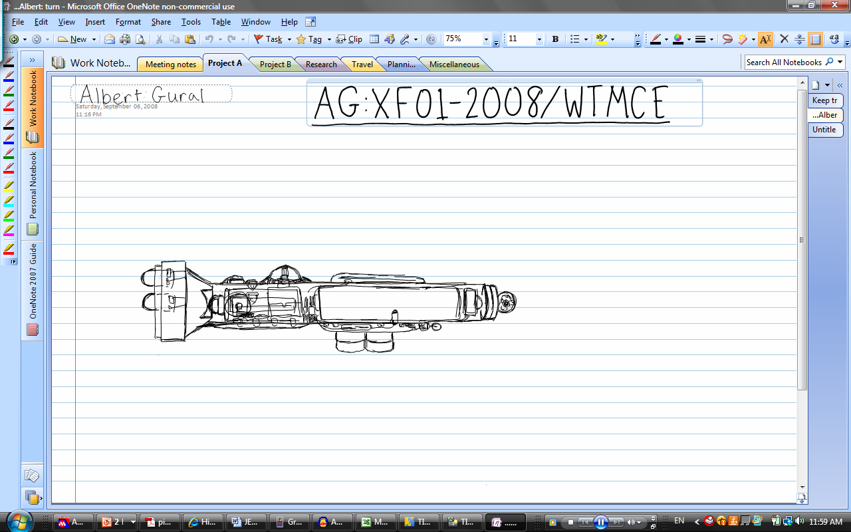
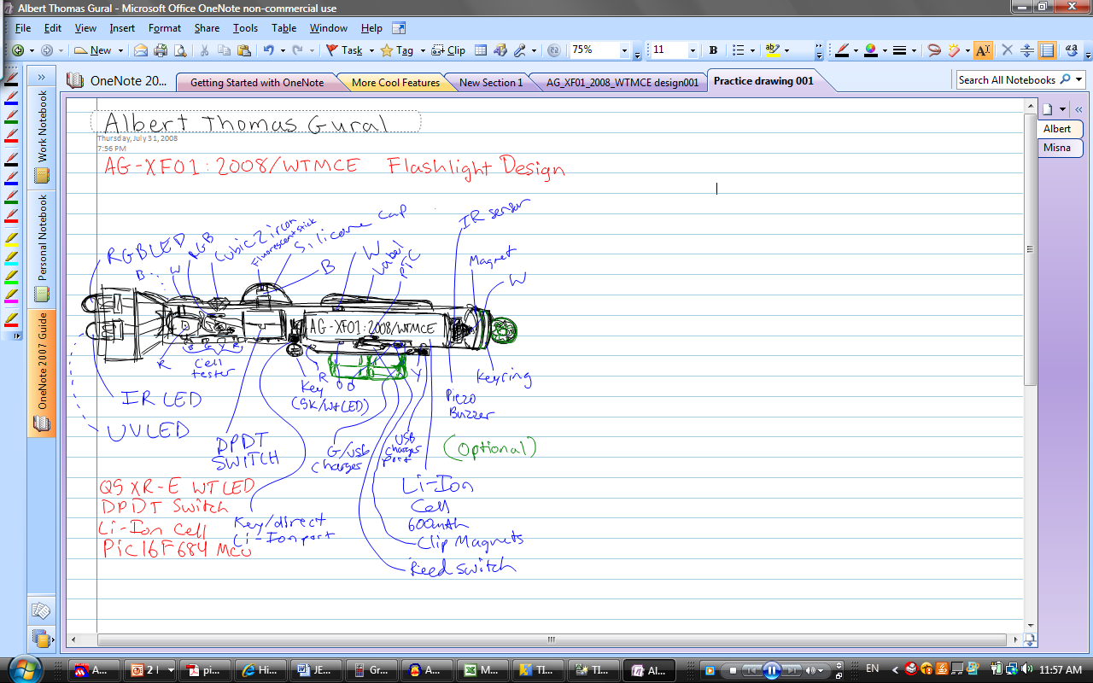
3.2 Original AG:XF Design

Slide 13
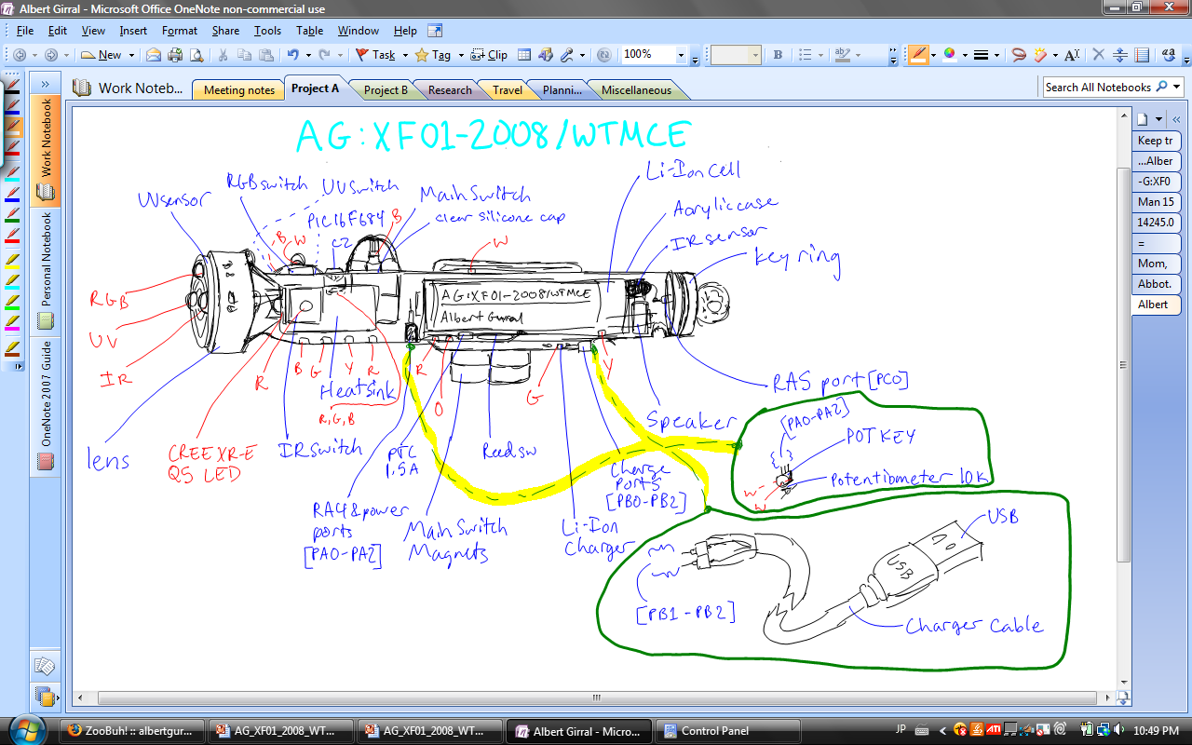
3.3 Final Design

Slide 14


3.4 Diagram
IR Switch
RGB Switch
Main Switch
Li-Ion
IR Sensor
RGB LED
Key Ring
IR LED
lens
(Q5 LED)
Charge Indicator
“heat sink”
10k pot acting as “key”
Master Magnets
(Master Safety Circuitry)
Charging Ports (and Li-Ion Charger)
Speaker
IR Sensor
Li-Ion
Main Switch
RGB Switch
UV Switch
RGB LED
Key Ring
UV LED
lens
Speaker
Charging Ports (and Li-Ion Charger)
(Master Safety Circuitry)
Master Magnets
10k pot acting as “key”
PIC16F684
Charge Indicator
(Q5 LED)
PCB control circuit

Slide 15
3.5 PCB layout

Slide 16
4.1 Schematic Diagram
Chapter 4 deals with specifications of the circuit.
Section 4.2 will deal with the designations for each of the I/O ports of the PIC16F684 chip.
Section 4.3 will deal with the entire circuit’s schematic diagram.

Slide 17
4.2 Port Designations
BKLT O
RA5
RA0
AN0
UVL O
SW I
AN3
RA4
RA1
AN1
RGBL O
IR I
RA3
RA2
IRL O
PIC 16F684
AN2
WL O
PWMA
RC5
RC0
AN4
SPK O
BL O
RC4
RC1
AN5
TEMP I
GL O
AN7
RC3
RC2
AN6
RL O

Slide 18
D3
UV
S3
100k
R3
100
D2
R1
S2
RGB
R4
100
D1
IR
R21
S1
R23
1k
D17
220
D21
D15
R20
B
R2
SPK
470
D20
100k
D16
R19
470
G
R5
NTC
D14
Y
D19
10k-RT
Q2
3V
R6
10k
NPN
R18
2k2
R
D18
B
R9
18k
U2
V+
IN
G
TS5A3166
IC Switch
R8
20k
NO
COM
GND
D4
R
R7
22k
R25
3k3
B
D13
AG:XF01-2008/WTMCE
W
D12
Albert Gural
W
D11
Gnd
RA0
RA1
RA2
RC0
RC1
1uF
RC2
R24
3k9
PIC16F684
C2
MCU
O
IR Receiver
D10
TSOP34838
Vcc
RA5
RA4
RA3
RC5
RC4
RC3
R22
U3
10M
R17
4k7
R
D9
PC0
R1
+
R10
KEY
10k
R2
10k
O
_
100
D2
W
D1
W
D5
R11
20k
Q1
XR-E WT
NPN
S5
R12
D6
B
I_{c}
Vcc
10k
STC4054
U1
Li-Ion Charger
CHRG
Gnd
R12
Bat
20k
C1
1uF
R14
3k3
R16
D8
Reed
1.5A
22k
Y
Li-Ion
PTC
R15
3.7V
S4
1k
+
D1
G
D7
R
R13
27k
PA0
PA1
PA2
PB0
PB1
PB2

Slide 19
5.1 Software Flowchart
Due to the complexity of the software flowchart, there will be several pages devoted to the flowchart, along with labels and wireless connectors to avoid confusion between different pages.
Notes:
-IR IN is normally 1, but becomes 0 when it receives an IR signal
-The controllable RGB LED is turned on by outputting a 0
-The ports designated to IR, RGB, and UV LED’s are normally inputs, unless a computer controlled output is neede.
-Initialization should set WDT to ~.1s; I/O ports (see 4.2)
-A set bit command, such as “set Wbit”, will set or clear every bit of the register, so that only one bit may be set at any time.
SW is the main switch
IRS is the IR switch
UVS is the UV switch
RGBS is the RGB switch
Unless otherwise noted, the sides of a decision diamond is a logic “1” and the bottom is a logic “0”.
A “call” command calls a subroutine, then returns
Ports RA<0:2> only become outputs when a test reveals that they are not manually on. This is to prevent a short-circuit; thus preventing a software restart.
For more detail on specific functions, see Chapter 6, assembly code.

Slide 20
5.21 Flowchart
Initialization
Main:
W
Y
V
Set W/Wbit on
Set Y/Ybit on
Set V/Vbit on
Clear XF STATUS
registers
Goto M
Goto M
Goto M
T
Test Temp;
>45 C
Goto R
Test Temp;
<0 C
Goto B
Return

Slide 21
5.22 Flowchart
C
Set C/Cbit on
Test RGBS
Goto W
Clear ports
CLRWDT; IROut
based on mode
CLRWDT; IROut SOS
SOS routine*
pause
Call T
Test SW
Test IRS
Test RGBS
Goto Y
Test UVS
Test RGBS
Goto V
*SOS (3Hz for 1s, 1s, 1Hz for 3s, 1s, 3Hz for 1s, 3s, repeat) use this pulse pattern for W LED and 440Hz, 1s on, 1s off for SPK.

Slide 22
5.23 Flowchart
F
Set Fbit; Clear ports
Set backlights
Start timer
Set RGB according to timer
Test time;
>1 min?
Goto W
Clear timer
CLRWDT; IROut
based on mode
Call T
Test SW
Test RGBS
Goto W
Test IRS
Test RGBS
Goto Y
Test UVS
Test RGBS
Goto V

Slide 23
5.24 Flowchart
B
R
Set B/Bbit on
Set R/Rbit on
Clear ports
Warning beep
CLRWDT; IROut
based on mode
Clear ports
Test Temp;
<-14 C
CLRWDT; IROut
based on mode
Goto
Main
Test Temp;
>5 C
Test Temp;
>55 C
Turn on W
LED based
on key
Test SW
Test Temp;
<40 C
Goto
Main
Test SW
Turn on W LED
25% of key
Flash LED 50%
duty @ 2Hz
CLRWDT
Clear ports
Test Temp;
>0 C
Warning beep/
CLRWDT
Test Temp;
<45 C

Slide 24
5.25 Flowchart
G
Set G/Gbit on
Clear Ports
Call T
CLRWDT
CLRWDT; IROut
based on mode
Test IRIn
Set W LED &
Speaker
Call T
Clear W LED
& Speaker*
N
Test IRIn;
Valid?
Y
N
Test IRIn;
Device?
Y
Put IRCODEI
to register
Invalid
Follow code;
Run 49ms
N
Test IRIn*
Y
*Reading the signal stops when the WDT resets the microcontroller.

Slide 25
5.31 Flowchart
M
Clear ports
Test RGBS
CLRWDT; IROut
based on mode
Test W bit
Goto
WS
Test Y bit
Goto
YS
Call T
Goto
VS
Test V bit
Test SW
Goto W
Test IRS
Test RGBS
Test UVS
Test RGBS
Goto F
Test W bit
Test Y bit
Goto C
Goto V
Goto W
Goto Y

Slide 26
5.41 Flowchart
WS
Clear ports
CLRWDT
Call T
Test SW
N
Goto M
Y
Send SW analog
value to reg.
Turn on W LED to SW
val. duty cycle @ 1KHz

Slide 27
5.42 Flowchart
YS
YSMS1
Clear ports
Set YSMS1 bit
Test bit0 YSMS
Goto
YSMS0
CLRWDT
Call T
YSMS0
N
Goto M
Test SW
Test bit5 YSMS
Goto
YSMS5
Y
Send SW analog
value to reg.
Set YSMS0 bit
CLRWDT
Flash on W LED ~.01s at
SW val. freq. (.1Hz – 100Hz)
Call T
RGBS press
> 1s?
N
Goto M
W LED on .2s
Test SW
Y
Goto
YSMS2
Send SW analog
value to reg.
Turn on W LED to SW
val. duty cycle @ 1KHz
RGBS press
> 1s?
Goto
YSMS1
W LED on .2s

Slide 28
5.42 Flowchart
YSMS2
Set YSMS2 bit
CLRWDT
Call T
Test SW
N
Goto M
Y
Send SW analog
value to reg.
Flash on W LED & SPK ~.01s
at SW val. freq. (1Hz – 1KHz)
RGBS press
> 1s?
Goto
YSMS3
W LED on .2s

Slide 29
5.42 Flowchart
YSMS3
YSMS32
YSMS34
Set YSMS3 bit
Set YSMS32 bit
Set YSMS34 bit
Clear ports
YSMS30
YSMS31
YSMS33
YSMS3
Reg. != 0?
Set YSMS31 bit
Set YSMS33 bit
Set YSMS30 bit
CLRWDT
Test YSMS32
N
Test YSMS33
N
Call T
N
Goto M
Y
Y
Test SW
Flash W LED
19% duty @ 4KHz
Flash W LED
50% duty @ 4KHz
Y
Test YSMS30
N
Test YSMS31
N
Y
Y
N
Test YSMS34
Flash W LED
.1% duty @ 4KHz
Flash W LED
2% duty @ 4KHz
Y
RGBS press
<1s ?
bit 5 set?
W LED on
Rotate YSMS3
bits left
Goto
YSMS30
RGBS press
> 1s?
W LED on .2s
Goto
YSMS4

Slide 30
5.42 Flowchart
YSMS4
YSMS42
YSMS44
Set YSMS4 bit
Set YSMS42 bit
Set YSMS44 bit
Clear ports
YSMS40
YSMS41
YSMS43
YSMS4
Reg. != 0?
Set YSMS41 bit
Set YSMS43 bit
Set YSMS40 bit
CLRWDT
Test YSMS42
N
Test YSMS43
N
Call T
N
Goto M
Y
Y
Test SW
Flash W LED
50% duty @ 2Hz
Flash W LED
50% duty @ 1Hz
Y
Test YSMS40
N
Test YSMS41
N
Y
Y
N
Test YSMS43
Flash W LED
50% duty @ 10Hz
Flash W LED
50% duty @ 5Hz
Y
RGBS press
<1s ?
bit 5 set?
Flash W LED
50% duty @ .1Hz
Rotate YSMS4
bits left
Goto
YSMS40
RGBS press
> 1s?
W LED on .2s
Goto
YSMS5

Slide 31
5.42 Flowchart
YSMS5
YSMS52
YSMS54
Set YSMS5 bit
Set YSMS52 bit
Set YSMS54 bit
Clear ports
YSMS50
YSMS51
YSMS53
YSMS5
Reg. != 0?
Set YSMS51 bit
Set YSMS53 bit
Set YSMS50 bit
CLRWDT
Test YSMS52
N
Test YSMS53
N
Call T
N
Goto M
Y
Y
Test SW
W LED 5Hz,
2s pd, 50% duty
W LED 10Hz,
2s pd, 50% duty
Y
Test YSMS50
N
Test YSMS51
N
Y
Y
N
Test YSMS53
W LED 2.5Hz,
10s pd, 50% duty
W LED 5Hz,
5s pd, 50% duty
Y
RGBS press
<1s ?
bit 5 set?
W LED 10Hz,
1 s, 50% duty
Rotate YSMS5
bits left
RGBS press
> 1s?
Goto
YSMS50
Goto
YSMS0
W LED on .2s

Slide 32
5.43 Flowchart
VS
VSMS1
Clear ports
Set VSMS1 bit
Test bit0 VSMS
Goto
VSMS0
CLRWDT
Call T
VSMS0
N
Goto M
Test SW
Test bit5 VSMS
Goto
VSMS5
Y
Send SW analog
value to reg.
Set VSMS0 bit
CLRWDT
Turn on SPK based on SW
val. from 10Hz – 1KHz
Call T
RGBS press
> 1s?
N
Goto M
W LED on .2s
Test SW
Y
Goto
VSMS2
Send SW analog
value to reg.
Turn on SPK based on SW
val. from .01 – 10Hz
RGBS press
> 1s?
Goto
VSMS1
W LED on .2s

Slide 33
5.43 Flowchart
VSMS3
Set VSMS3 bit
VSMS2
CLRWDT
Set VSMS2 bit
Call T
CLRWDT
Goto M
Test SW
N
Call T
Test SW
N
Goto M
Y
Send SW analog
value to reg.
Y
Send SW analog
value to reg.
Turn on SPK note based on
SW val. (see table 10.222)
Turn on SPK based on SW
val. from 1KHz – 64KHz
RGBS press
> 1s?
W LED on .2s
RGBS press
> 1s?
W LED on .2s
Goto
VSMS4
Goto
VSMS3

Slide 34
5.42 Flowchart
VSMS4
VSMS42
VSMS44
Set VSMS4 bit
Set VSMS42 bit
Set VSMS44 bit
Clear ports
VSMS40
VSMS41
VSMS43
VSMS4
Reg. != 0?
Set VSMS41 bit
Set VSMS43 bit
Set VSMS40 bit
CLRWDT
Test VSMS42
N
Test VSMS43
N
Call T
N
Goto M
Y
Y
Test SW
SPK 2s of 12KHz
every 2min.
SPK 5s of 3.5KHz
every 10min.
Y
Test VSMS40
N
Test VSMS41
N
Y
Y
N
Test VSMS43
SPK 2s of 440Hz
every 2min.
SPK 2s of 3.5KHz
every 2min.
Y
RGBS press
<1s ?
bit 5 set?
SPK 5s of 12KHz
every 10min.
Rotate VSMS4
bits left
Goto
VSMS40
RGBS press
> 1s?
W LED on .2s
Goto
VSMS5

Slide 35
5.43 Flowchart
VSMS5
Set VSMS5 bit
Clear ports
VSMS50
VSMS51
VSMS5
Reg. != 0?
Set VSMS51 bit
Set VSMS50 bit
CLRWDT
Call T
Test SW
N
Goto M
Y
Test VSMS50
N
Test VSMS51
N
Y
Y
Play Binary
Song (C Major)
Play Birthday
Song (F Major)
RGBS press
<1s ?
Rotate VSMS5
bits left
bit 2 set?
Goto
VSMS50
RGBS press
> 1s?
W LED on .2s
Goto
VSMS0

Slide 36
6.0 AG:XF01 Assembly Code
For the assembly code for the AG:XF01-2008/WTMCE flashlight, see AG:XF01 OS v1.00

Slide 37
7.1 IR Transceiving
Chapter 7 deals with the timing and code characteristics in relation to IR transmitting and receiving of the AG:XF01-2008/WTMCE.

Slide 38
7.21 IR Code Timing
The transmission starts with a 2.6ms lead signal followed by 16 data bits separated by 520us silence periods. A data ‘0’ is 520us, while a data ‘1’ is 1040us. The first 6 bits consist the device code, the remaining 10 bits are the instruction code bits. This is repeated every 100ms.

Slide 39
7.22 IR Code Timing
(000001) (1111101000)
Lead Signal
Device Code
Instruction Code
38.15 KHz
13us

Slide 40
7.3 IR Instruction Code Table*
IR Instruction Codes (AG:XF01 OS v1.00)
Group | HEX | Instruction | Group | HEX | Instruction
Flashlight Output Codes | 000 | White mode | Instruction Codes | 020-027 | Send Device Code
 | 001 | Red mode |  | 028-02F | IR LED
 | 002 | >55*C (Warning) |  | 030-037 | RGB LED
 | 003 | Blue mode |  | 038-03F | UV LED
 | 004 | <-14*C (Warning) |  | 040-04F | Chromatic Scale
 | 005 | Cyan mode |  | 050-057 | SOS Output
 | 006 | SOS (Warning) |  | 058-05F | Backlight
 | 007 | Yellow mode |  | 060-067 | Binary Song
 | 008 | Violet mode |  | 068-06F | Birthday Song
 | 009 | Flashing mode |  | 070-07F | White LED PWM [(low) = .1% step]
 | 00A | Device Code Out |  | 080-0FF | White LED PWM [(low) = .5% step]
 |  | Unimplemented |  | 100-3FF | Unimplemented
FOC Alt.
00B-01F
IC Alt.
*Also found in section 10.3

Slide 41
10.1
Chapter 10 deals with a simplified way to see the various modes and functions split into:
  10.2: XF modes
  10.31: Yellow modes
  10.32: Violet modes
  10.4: IR instructions

Slide 42
10.2 Tables
The first table illustrates the main flashlight modes controlling how the flashlight acts when certain buttons are pressed. The table includes what color the status LED should be, the IROut codes, the mode name, the description of that mode, and how to get to that mode. Note that the flashlight may be in any one of those modes, depending on the surroundings or keypresses. For example, to get to Y mode (Flashing output mode), press and hold the switch to turn on the IR light, then quickly press the switch for RGB. This can only be done in W, C, V, or F mode. Also note that at startup, or after R, G, or B modes are finished, the flashlight will go to W mode. B mode serves as a warning of low temperature, but will not hinder any component from working, since this may help stabilize temperature.
Status LED/ IRCODE: | Mode: | Description: | How to change to mode:
White/ W/ h'0100' | Main output mode | W LED out varies with key setting | Under Y, C, B, V, F mode; hold main switch, then press RGB
Red/ R/ h'0101', h'0102 | Hyperthermia mode | W LED power is cut by 3/4 duty cycle | Under any mode; temp > 45C
Yellow/ Y/ h'0107' | Flashing output mode | W LED flashes according to user | Under W, C, V, F mode; hold IR, then press RGB
Green/ G/ n/a | IR receive mode | Receive IR signals and follow instructions | Under W, Y, G, C, B, V, F mode while no externalities in operation; detects IR signal
Cyan/ C/ h'0105’-h’0106’ | IR + Warning mode | Output an IR SOS signal along with a LED + SPK SOS output | Under Y mode; hold IR, then press RGB
Blue/ B/ h'0103', h'0104 | Hypothermia mode | Same as W mode | Under any mode; temp < 5C
Violet/ V/ h'0108' | Sound output mode | Output a certain sound according to key setting | Under W, Y, C, V, F mode; hold UV, then press RGB
Flashing/ F/ h'0109' | Backlights/ display mode | Display backlights and power level | Under W mode; hold RGB, then press main switch
Table 10.11

Slide 43
10.31 Tables, cont.
This next table shows the sub-modes and levels of sub-modes for Y. It also includes C mode (SOS). To toggle between sub-modes (rows), hold RGBS at least 1s. To get to SOS mode, hold IR then press RGB, when in Y mode. Within the sub-modes, Levels can be changed according to sub-mode. For example, to change brightness level in “Key control brightness” sub-mode, simply change the port key. To change frequency in “Leveled frequency”, quickly press the RGB switch. Note: in all of these cases, the main switch must be on to switch sub-mode (or levels of the sub modes).
Yellow Mode
Mode | Levels |  |  |  |  | Change sub-mode | Change level
Key control brightness (YSMS0) | 0% - 100% duty cycle |  |  |  |  | Hold RGBS > 1s | Change key
Key control frequency (YSMS1) | .1Hz - 100Hz |  |  |  |  | Hold RGBS > 1s | Change key
Key control frequency + sound (YSMS2) | .1Hz – 100Hz |  |  |  |  | Hold RGBS > 1s | Change key
Leveled brightness (YSMS3) | 0.1% duty | 1.95% duty | 18.75% duty | 50% duty | 100% duty | Hold RGBS > 1s | Tap RGBS
Leveled frequency (YSMS4) | 10Hz | 5Hz | 2Hz | 1Hz | .1Hz | Hold RGBS > 1s | Tap RGBS
Leveled pulse frequency out (YSMS5) | 5Hz, .1Hz @ 50% | 5Hz, .2Hz @ 50% | 10Hz, .2Hz @ 50% | 10Hz, 1Hz @ 50% | 20Hz, 2Hz @ 50% | Hold RGBS > 1s | Tap RGBS
Alarm signal (C Mode) | SOS (3Hz for 1s, 1s, 1Hz for 3s, 1s, 3Hz for 1s, 3s, repeat) and alarm sound |  |  |  |  | Hold IR, press RGB | n/a
Bit 0
Bit 1
Bit 2
Bit 3
Bit 4
Table 10.21

Slide 44
10.32 Tables, cont.
This next table shows the sub-modes and levels of sub-modes for V. To toggle between sub-modes (rows), hold RGB switch for at least a second. Within the sub-modes, levels can be changed according to sub-mode. For example, to change frequency level in “Low-Frequency” sub-mode, simply change the port key. To change the beep pattern in “Periodic Beep”, tap the RGB switch. Note: in all of these cases, the main switch must be on to switch sub-mode (or levels of the sub modes). Also, the frequency and cycle width of the chromatic scale levels are provided in table 10.222. For example, to get a ‘D’ at 4MHz osc., turn SPK on for 851 instruction cycles, then off 852 instruction cycles and repeat or turn SPK on for 1 cycle and off for 1702-03 cycles.
Violet Mode
Sub-Mode | Levels |  |  |  |  | Change sub-mode | Change level
LF (VSMS0) | .01Hz - 10Hz |  |  |  |  | hold RGBS > 1s | Change Key
MF (VSMS1) | 10Hz - 10KHz |  |  |  |  | Hold RGBS > 1s | Change Key
HF (VSMS2) | 1KHz – 100KHz |  |  |  |  | Hold RGBS > 1s | Change Key
Scale (VSMS3) | Mid C - High C (523.2862 - 1046.0251)* |  |  |  |  | Hold RGBS > 1s | Change Key
Periodic Beep (VSMS4) | 2s 440Hz every 2min | 2s 7KHz every 2min | 2s 15KHz every 2min | 5s 7KHz every 10min | 5s 15KHz every 10min | Hold RGBS > 1s | Tap RGBS
Binary/ Birthday (VSMS5) | 0000,0001,…1111,0000, etc. |  |  |  |  | Hold RGBS > 1s | Tap RGBS
Birthday Song
Table 10.221
Note
Frequency
# of Cycles
Note
Frequency
# of Cycles
C
261.6431
3822
G
392.0031
2551
C#
277.1619
3608
G#
415.2824
2408
D
293.6858
3405
A
439.9472
2273
D#
311.1388
3214
A#
466.2005
2145
E
329.5979
3034
B
493.8272
2025
F
349.2840
2863
C
523.2862
1911
F#
369.9593
2703
*Table 10.222

Slide 45
10.4 IR Instruction Code Table
IR Instruction Codes (AG:XF01 OS v1.00)
Group | HEX | Instruction | Group | HEX | Instruction
Flashlight Output Codes | 000 | White mode | Instruction Codes | 020-027 | Send Device Code
 | 001 | Red mode |  | 028-02F | IR LED
 | 002 | >55*C (Warning) |  | 030-037 | RGB LED
 | 003 | Blue mode |  | 038-03F | UV LED
 | 004 | <-14*C (Warning) |  | 040-04F | Chromatic Scale
 | 005 | Cyan mode |  | 050-057 | SOS Output
 | 006 | SOS (Warning) |  | 058-05F | Backlight
 | 007 | Yellow mode |  | 060-067 | Binary Song
 | 008 | Violet mode |  | 068-06F | Birthday Song
 | 009 | Flashing mode |  | 070-07F | White LED PWM [(low) = .1% step]
 | 00A | Device Code Out |  | 080-0FF | White LED PWM [(low) = .4% step]
 |  | Unimplemented |  | 100-3FF | Unimplemented
FOC Alt.
00B-01F
IC Alt.

Slide 46
11.1
Chapter 11 details how to operate the flashlight.
Section 11.2 shows parts and functions along with what they do.
Section 11.3 details how to change between modes and settings.
Section 11.4 details more complex features

Slide 47
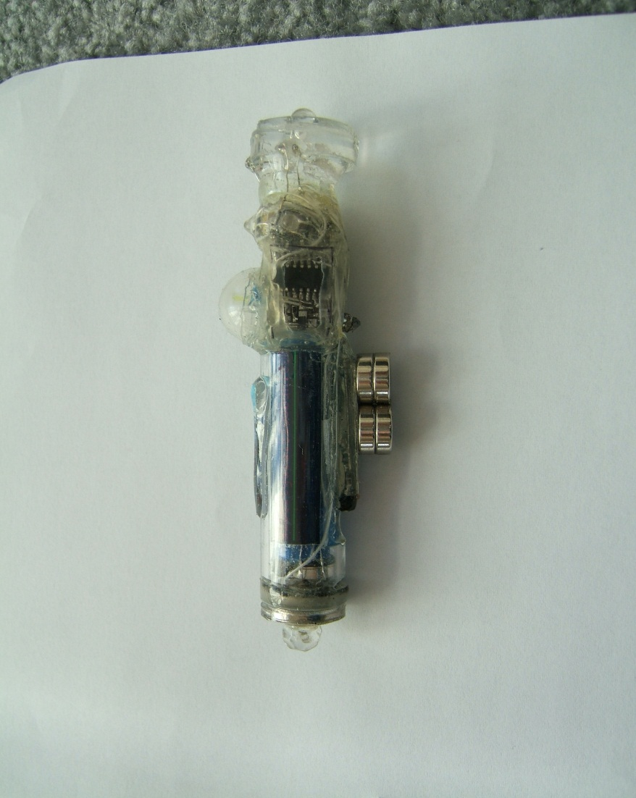
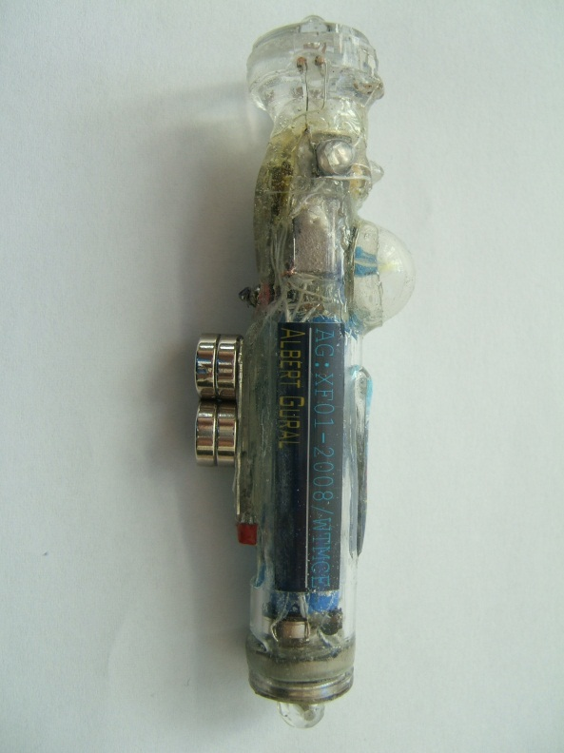
11.2 labeled parts
23.
0. RGB LED
RGB Switch
Mode Status Indicator
PIC16F684 MCU
Main Switch (lighted)
Acrylic Case
AG LOGO (lighted)
Li-Ion Cell
IR sensor
Keychain Attachment
Back Magnet/ RA5 I/O
Speaker
Contact Information
Charge/ Att. Ports
IC Cell Charger (lighted)
Light Exposure Warning
NdFeB Magnets
Safety Circuitry
Key in RA4 I/O
Main Circuit Board (PCB)
Cell Voltage Indicator
UV Switch
Lens
UV LED
IR LED
CREE XR-E Q5 LED
IR Switch
Model and Owner Information
0.
22.
1.
21.
2.
20.
3.
19.
4.
18.
5.
17.
6.
16.
15.
14.
13.
7.
12.
8.
11.
10.
9.
24.
0.
22.
25.
26.
1.
20.
2.
23.
18.
4.
17.
5.
16.
15.
6.
14.
13.
27.
7.
11.
8.
10.
9.

Slide 48
11.2 Explanation of Parts
0. RGB LED: Displays a flashing light pattern of different colors
RGB Switch: Turns on RGB LED and is used to change flashlight mode
Mode Status Indicator: Displays a 1-bit color based on flashlight mode
PIC16F684 MCU: “Computer”: Controls much of flashlight
Main Switch (lighted): Turns on pin RA4 to turn on Q5 LED and is used to change flashlight mode
Acrylic Case: Covers parts in tough, see-through plastic)
AG LOGO (lighted): Shows ID#01
Li-Ion Cell: Provides flashlight power
IR sensor: Senses and sends IR signals to MCU to be processed
Keychain Attachment: Attaches to back magnet
Back Magnet/ RA5 I/O: Can hold different attachments and has connection to MCU ping RA5
Speaker: Emits soft tones for Sound Output modes
Contact Information: Shows contact information of owner
Charge/ Att. Ports: Used to charge Li-Ion or get power for Att.
IC Cell Charger (lighted): Charges Li-Ion and shows charge finish
Light Exposure Warning: Label warning about flashlight light intensity
NdFeB Magnets: Stabilizes flashlight up and turns on master switch
Safety Circuitry: Master reed switch and 1.5A PTC resettable fuse
Key in RA4 I/O: Controls pin RA4 (set for brightness and speed controls)
Main Circuit Board (PCB): MCU and many hardware components
Cell Voltage Indicator: Uses B,G,Y,R LED’s to indicate Cell charge level
UV Switch: Turns on UV LED and is used to change flashlight mode
Lens: Contains IR, RGB, and UV LED’s; focuses Q5 LED light
UV LED: Outputs UV light (~395nM)
IR LED: Outputs IR light (~808nM)
CREE XR-E Q5 LED: Main White LED for high brightness output
IR Switch: Turns on IR LED and is used to change flashlight mode
Model and Owner Information: Shows model, owner, and important construction dates

Slide 49
11.31 Software Operation
The flashlight has 8 main modes [W,R,Y,G,C,B,V,F], sub-modes, and levels:
  White mode (W): Puts out a PWM White LED light (dependent on RA4 voltage) [get to W by pressing MS&RGBS from Y,C,V,F]
  Red mode (R): Indicates too high LED temperature [get to R by getting Q5(WLED) too hot]
  Yellow mode (Y): Puts out flashing white LED patterns [get to Y by pressing IRS & RGBS from W,C,V]
    Sub-mode 0: Variable brightness [get to YSM0 by holding RGBS>1s from YSM5]
    Sub-mode 1: Variable strobe [get to YSM1 by holding RGBS>1s from YSM0]
    Sub-mode 2: Variable strobe + sound [get to YSM2 by holding RGBS>1s from YSM1]
    Sub-mode 3: Leveled brightness [get to YSM3 by holding RGBS>1s from YSM2]
      Level 0: 0.1% Duty Cycle [get to YSM3L0 by tapping RGBS from YSM3L4 under YSM3]
      Level 1: 2% Duty Cycle [get to YSM3L1 by tapping RGBS from YSM3L0]
      Level 2: 19% Duty Cycle [get to YSM3L2 by tapping RGBS from YSM3L1]
      Level 3: 50% Duty Cycle [get to YSM3L3 by tapping RGBS from YSM3L2]
      Level 4: 100% [get to YSM3L4 by tapping RGBS from YSM3L3]
    Sub-mode 4: Leveled strobe [get to YSM4 by holding RGBS>1s from YSM3]
      Level 0: 10Hz [get to YSM4L0 by tapping RGBS from YSM4L4 under YSM4]
      Level 1: 5Hz [get to YSM4L1 by tapping RGBS from YSM4L0]
      Level 2: 2Hz [get to YSM4L2 by tapping RGBS from YSM4L1]
      Level 3: 1Hz [get to YSM4L3 by tapping RGBS from YSM4L2]
      Level 4: 0.1Hz [get to YSM4L4 by tapping RGBS from YSM4L3]
    Sub-mode 5: Leveled pulsed strobe [get to YSM5 by holding RGBS>1s from YSM4]
      Level 0:
    [incomplete]

