Slide 1
Microprocessor Controlled Oscilloscope
Albert Gural, Sarah Munyan

Slide 2
Plan
Get a simple LED-blinking circuit operational
Add an ADC input to the microprocessor
Add an LCD output to the microprocessor
Code a simple Oscilloscope

Slide 3
Initial LED Blinking Circuit
MC6802 microprocessor
OKI 28C16A ROM
LS373 Latch
LS240 Buffer
Hand-wired logic

Slide 4
Initial LED Blinking Circuit
Buffer
ROM
MPU
Logic
Latch
LEDs and Drivers

Slide 5
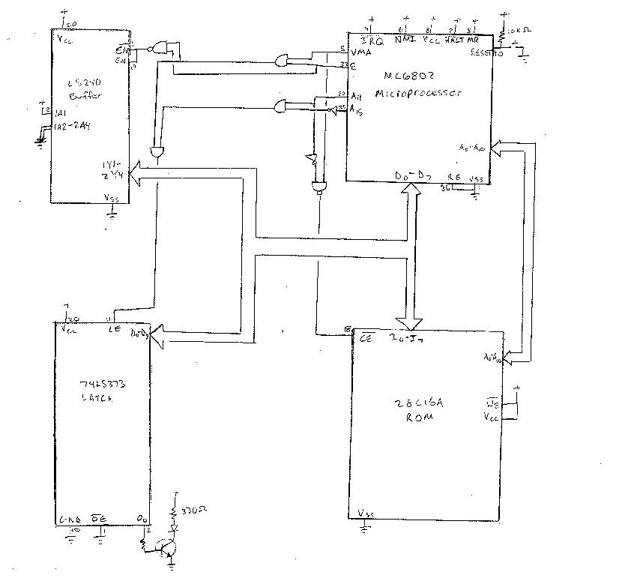
Initial LED Blinking Circuit

Slide 6
Initial LED Blinking Circuit Code
LATCH = $$7FFF
.area MAIN (ABS)
.org $$0100
main: LDAA #$$00
LDS #$$007F
m2: INCA
BSR pause
STAA LATCH
BRA m2
pause: LDAB #$$FF
p2: DECB
BEQ p3
BRA p2
p3: RTS

Slide 7
Initial LED Blinking Circuit Problems
LOTS of wiring for logic
Tri-state buffer
  Too complicated
  Too rigid
  Takes up address space
Latch triggering
  Fixed by not-ing the enable pin

Slide 8
Final LED Blinking Circuit
MC6802 microprocessor
OKI 28C16A ROM
LS373 Latch
LS138 Decoder

Slide 9
Final LED Blinking Circuit
ROM
MPU
Decoder
Latch
LEDs and Drivers

Slide 10
Final LED Blinking Circuit Solutions
Wiring for logic eliminated through use of decoder
No tri-state buffer needed
Showed that microprocessor system worked

Slide 11
ADC Circuit
MC6802 microprocessor
OKI 28C16A ROM
LS373 Latch
LS183 Decoder
0804 ADC

Slide 12
ADC Circuit
ADC
Latch
ROM
External Inputs
MPU
Decoder
Latch
LEDs and Drivers

Slide 13
ADC Circuit Code
LATCH = $$0100
ADC = $$4000
LCD = $$8000
.area MAIN (ABS) .org $$0100
main: LDAA ADC STAA LATCH BRA main

Slide 14
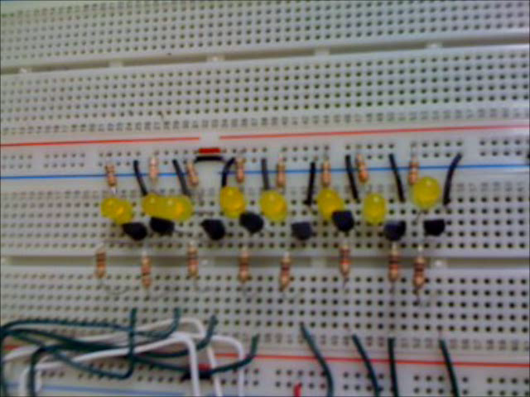
ADC Circuit Video

Slide 15
LCD Circuit
MC6802 microprocessor
OKI 28C16A ROM
LS373 Latch
LS183 Decoder
LCD Display

Slide 16
LCD Circuit
ROM
MPU
Decoder
LCD Display
Latch
Latch

Slide 17
LCD Problems
Difficult to interface with the LCD
LCD required:
  8 data pins
  3 control pins (D/I, CS1, CS2)
  2 8-bit Latches
LCD timing

Slide 18
Oscilloscope Circuit
MC6802 microprocessor
OKI 28C16A ROM
LS373 Latch
LS183 Buffer
0804 LCD
LCD Display

Slide 19
Oscilloscope Circuit Address Map
2¹⁵ | 2¹⁴ | 2⁸
0 0 1
000
001
010
011
100
101
110
111
RAM
n/a
ADC
n/a
LCD
control
LCD
data
ROM
ROM

Slide 20
Oscilloscope Circuit
External Inputs
ADC
ROM
MPU
Decoder
LCD Display
Latch
Latch
Latch

Slide 21
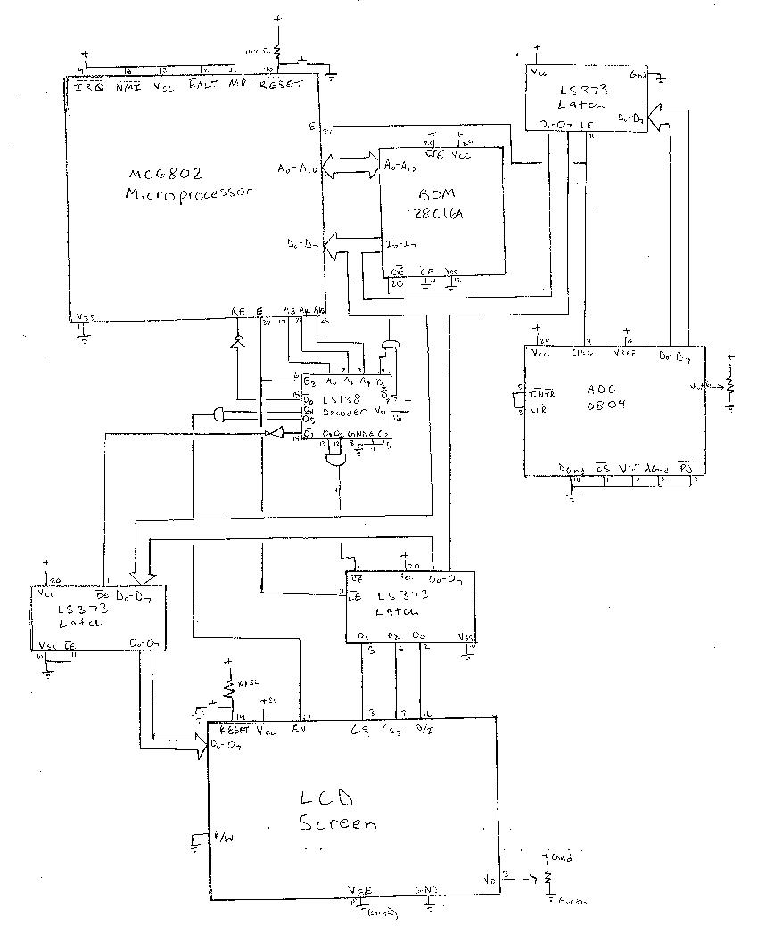
Oscilloscope Circuit

Slide 22
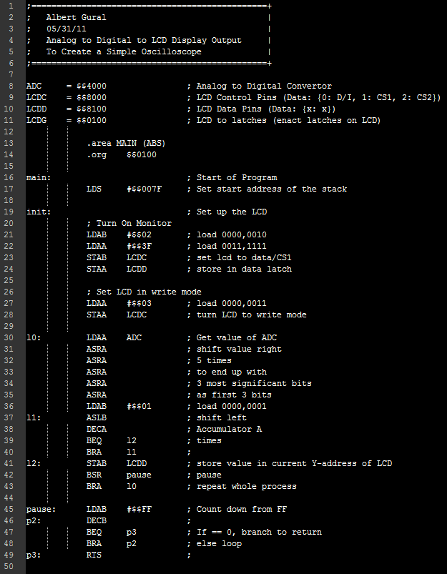
Oscilloscope Circuit Code

Slide 23
Oscilloscope Circuit Problems
Lots of difficulty getting the LCD to display the correct information
  Still getting a lot of garbage on the LCD
LCD timing (if any)

Slide 24
Conclusion
Successful in getting everything except the LCD to work
Only a few more days would be needed to fix the LCD issue

Slide 25
Going Farther
Multiple ADC’s could be tied together to allow for a multi-input oscilloscope
More powerful processor could be used to get higher sample rates

Slide 26
Acknowledgements
Mr. Montgomery
Mr. Bell
Nick Arango
Ned Danyliw
Mr. Dela Cuesta

Slide 27
Questions?

